Slide 1
LAMP Contacts Manager

Slide 2
Team Members
Project Manager – Drake Austin
Database – Drake
API – Drake A.
Frontend – Mr. Austin

Slide 3



Technology Used
Digital Ocean
GitHub
Visual Studio Code
Postman

Slide 4
What went well?/What didn't go well?
What went well? | What didn't go well?
Expanding my knowledge on computer science tools (i.e. Git, Postman) Developing a full-functioning website | Constant switching between the website's root and my GitHub repo Time management (due to shortened project timeframe and final exams)

Slide 5
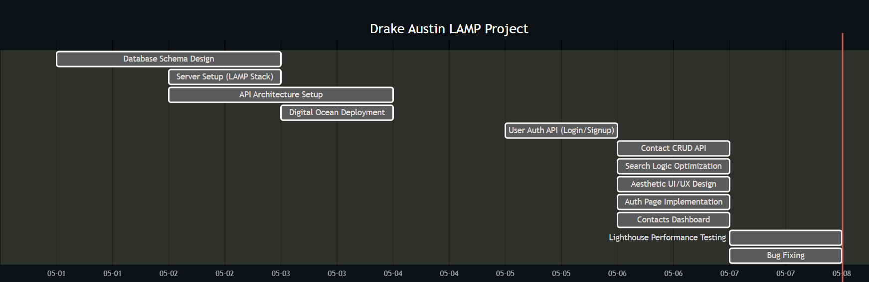
Gantt Chart

Slide 6
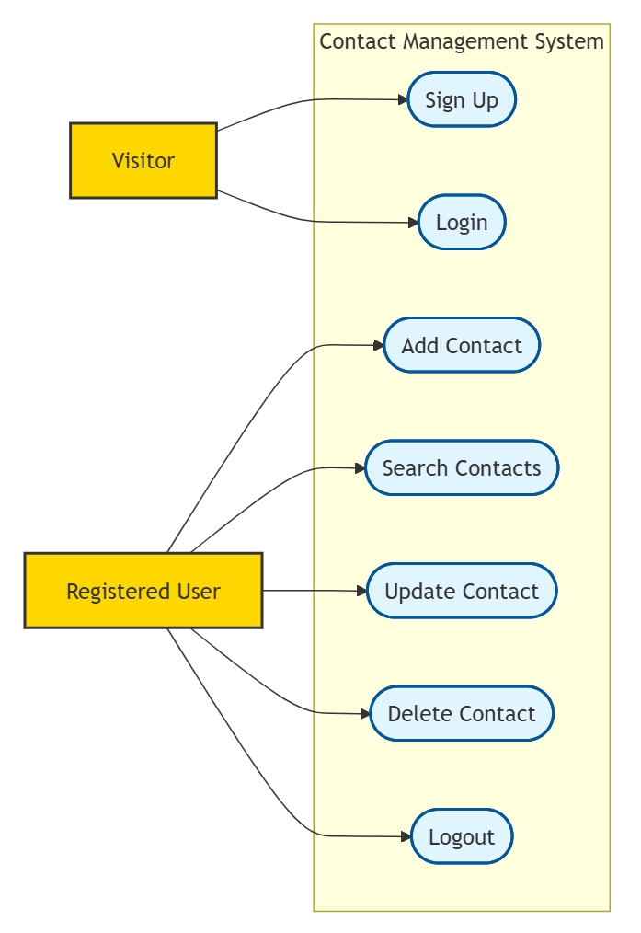
Use Case Diagram

Slide 7
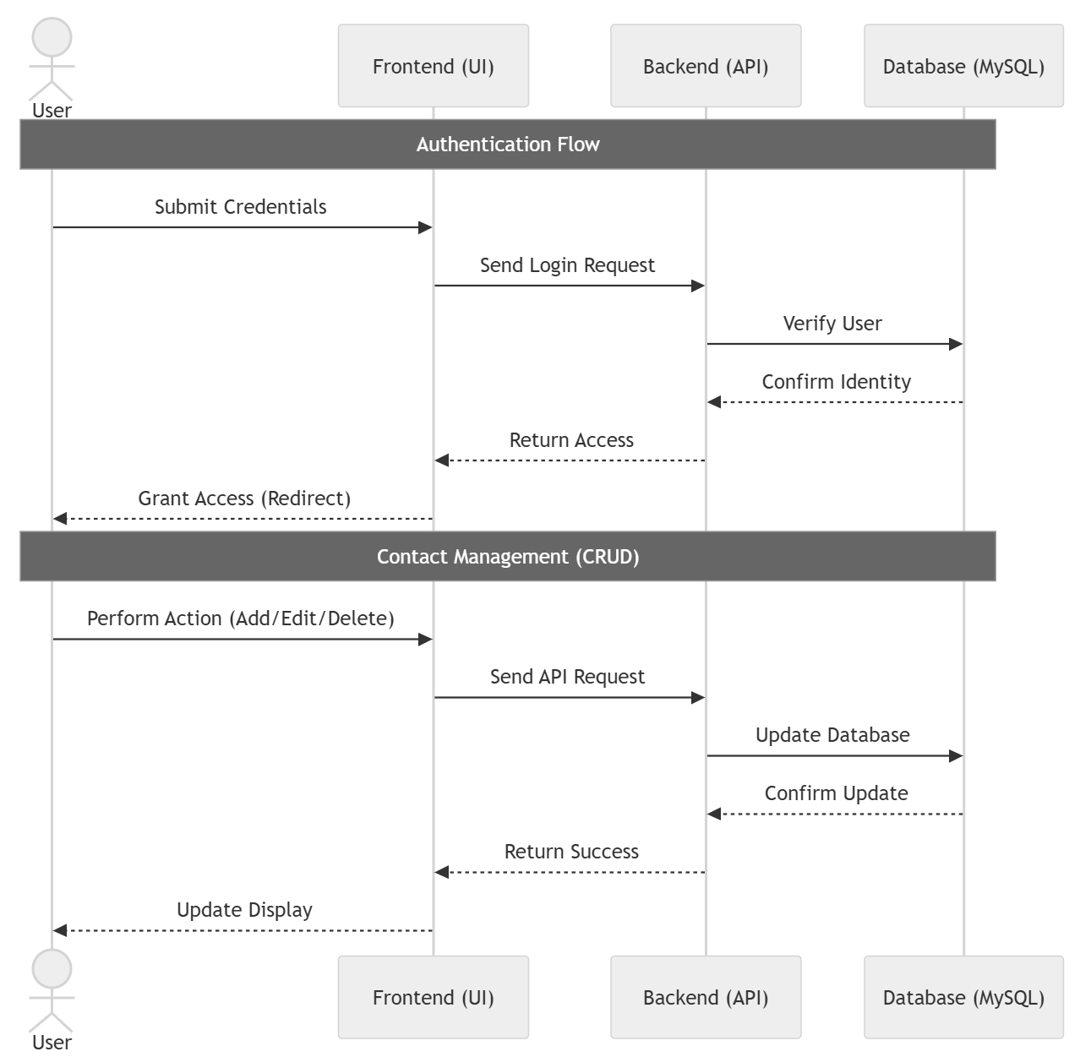
Sequence Diagram

Slide 8
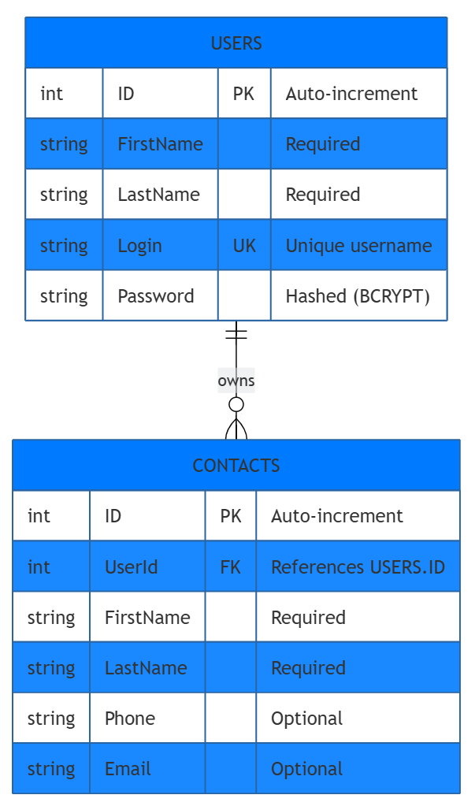
Entity Relationship Diagram

Slide 9
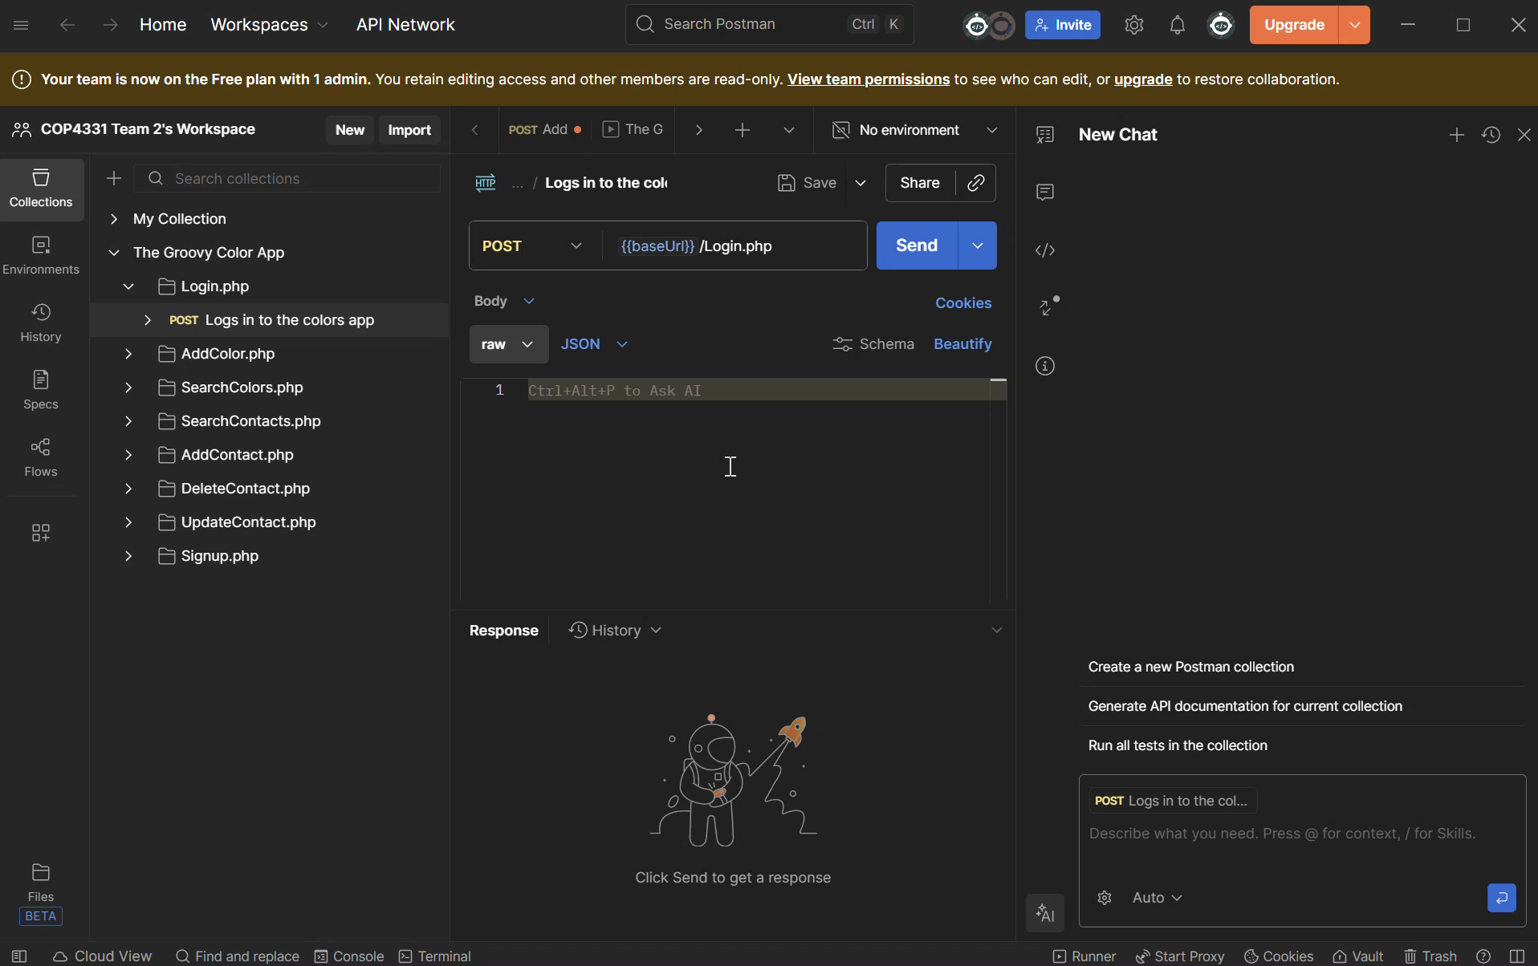
API Demo

Slide 10
App Demo
Link to site
(Dr. Aedo said no time for video in the email)

Slide 11
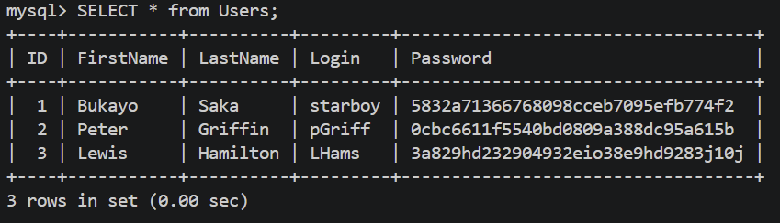
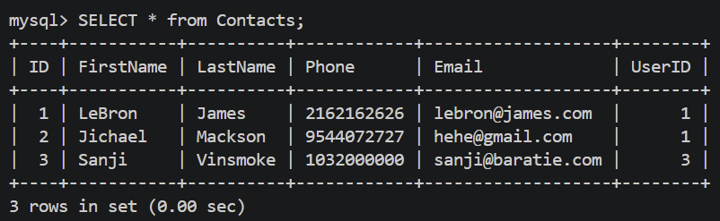
Database Demonstration

Slide 12
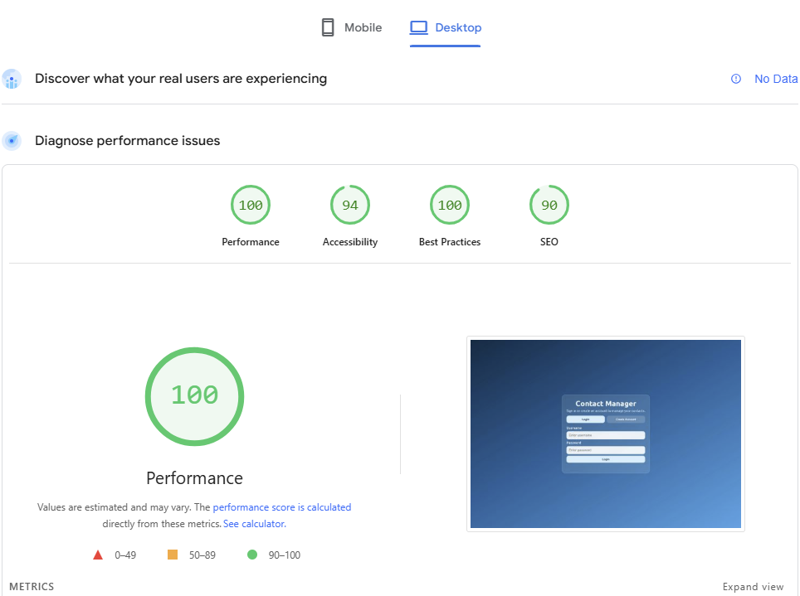
Lighthouse Tests

Slide 13
AI Disclosure
I utilized ChatGPT to understand how the APIs allow the client and server to interact with one another
I used Cursor to aid me with the development of the frontend

Slide 14
Questions?

